Slide 1
Improving Latent Representations of ConvNets for Visual Understanding
Amélioration des représentations latentes des ConvNets pour l'interprétation de données visuelles
Thomas Robert – 3 octobre 2019
JURY DE THESE
Rapporteurs
Stéphane Canu
Greg Mori
Examinateurs
Catherine Achard
Kartheek Alahari
David Picard
Encadrants
Matthieu Cord
Nicolas Thome

Slide 2
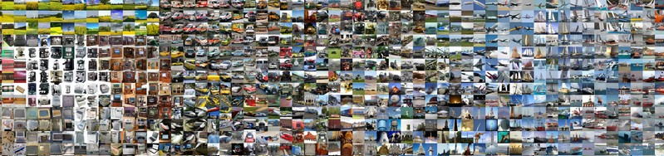
Visual content in the digital era
Exponential increase in quantity of images/videos taken across the world
Youtube: 500h of video / min
Facebook: 300M photos / day
How to extract semantic information?

Slide 3
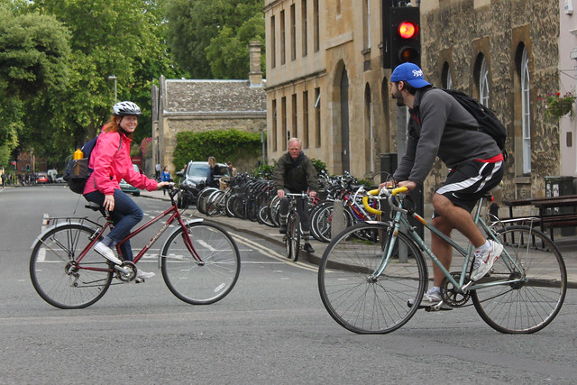

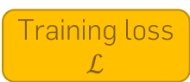
Computer Vision and Machine Learning
w
Parameters
Optimization algorithm
Input image to analyze
Prediction model f
Prediction
$$\hat{y}$$
Training loss
$$ℒ$$
Tasks
Classification
Object detection
Segmentation
Captioning
…
traffic light
person
a girl in a pink jacket on a bicycle passes a man in a blue cap on a bicycle.
✓ Street
✘ Office
✘ Bedroom
✘ …
person
person
car
bike
bike
bike
Visually impaired assistant
Defect detection
Photo search
Autonomous driving

Slide 4
Deep Learning
LeNet-5
LeCun (1998)
Convolution
MaxPool
AvgPool
Concat
Dropout
Fully connected
Softmax
Residual add
AlexNet
Krizhevsky (2012)
VGG-16
Simonyan (2015)
2x
5x
2x
Inception V1
Szegedy (2015)
3x
8x
36x
3x
ResNet-152
He (2016)
more depth → more parameters → more data
Convolutions
Skip-connections
ImageNet
1.3M images
1000 classes
10-100M

Slide 5
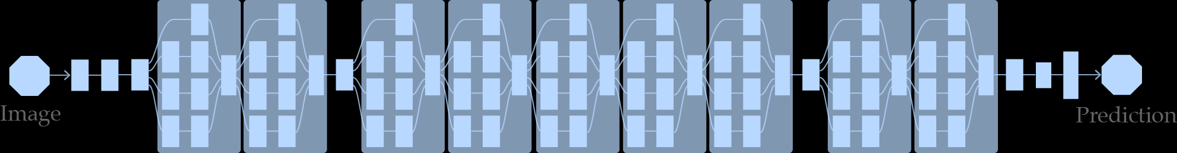
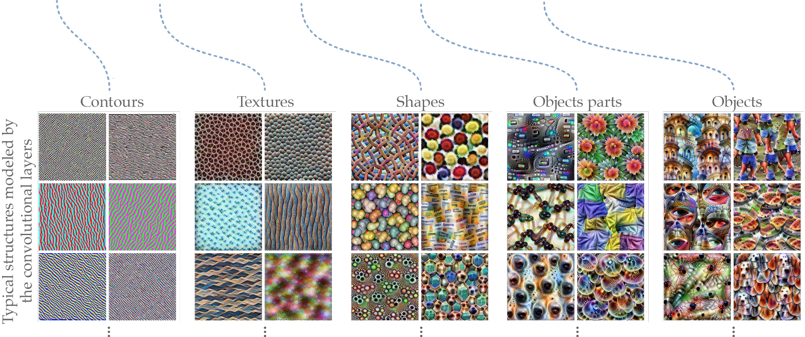
Typical deep learning model
Deep ConvNet = succession of latent representations
No semantic structure a priori
Credits: Olah (2017)

Slide 6
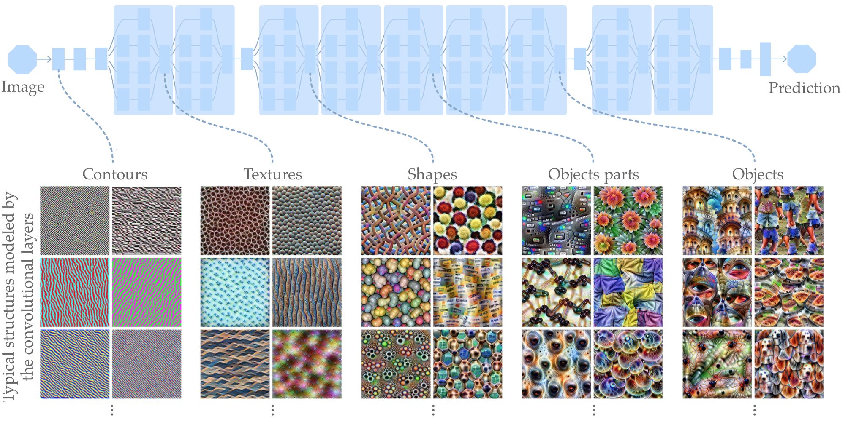
Motivations and contributions
Motivations
Axes
Contribution
Regularization generalize better with less data
Semi-supervised learning use unlabeled data
Information structuration in two branches
Disentangling of semantic factors
1
Models require large labeled datasets
Latent representations are unstructured
SHADE
2x
5x
2x
2
HybridNet
3
DualDis

Slide 7
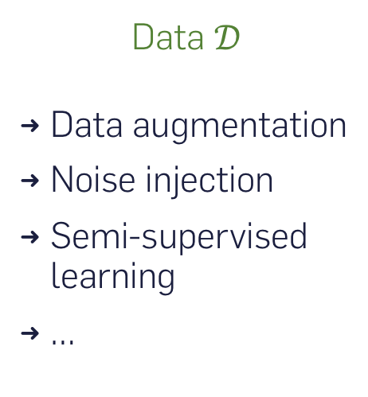
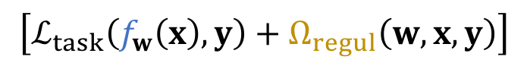
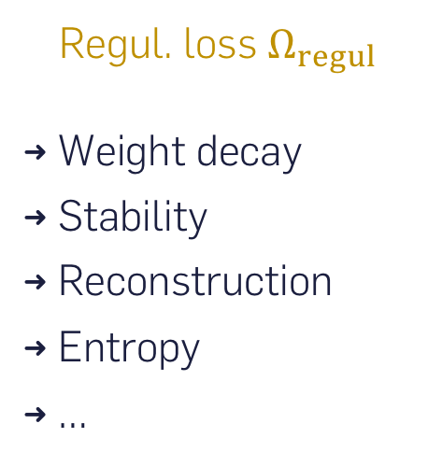
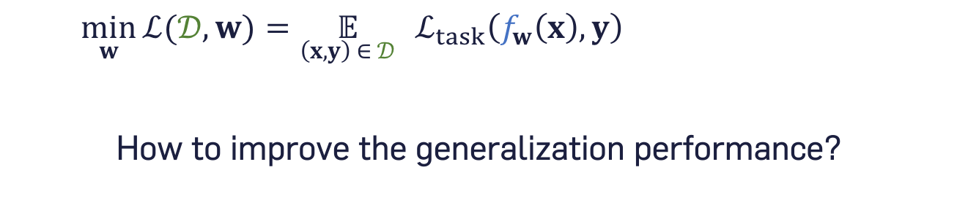
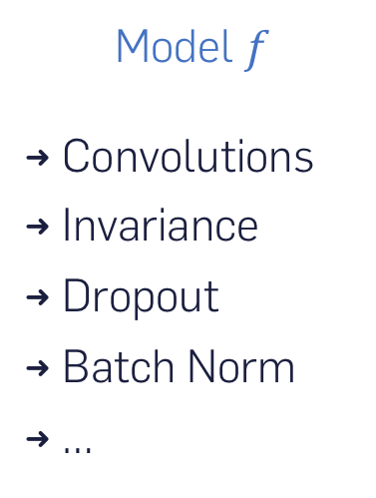
Training and improving deep ConvNets
$$\left[ℒ_{task}\left(f_{w}\left(x\right),y\right)+Ω_{regul}\left(w,x,y\right)\right]$$
$$\min_{w}{ℒ(𝒟, w)}=\underset{\left(x,y\right) ∈ 𝒟}{𝔼} \left[ℒ_{task}\left(f_{w}\left(x\right),y\right)+Ω_{regul}\left(w,x,y\right)\right]$$
How to improve the generalization performance?
Data $𝒟$
Data augmentation
Noise injection
Semi-supervised learning
…
Model $f$
Convolutions
Invariance
Dropout
Batch Norm
…
Regul. loss $Ω_{regul}$
Weight decay
Stability
Reconstruction
Entropy
…
3
2
2
1

Slide 8
Regularization SHADE: Invariance through Conditional Entropy Minimization
SHADE: Information-Based Regularization for Deep Learning Michael Blot, Thomas Robert, Nicolas Thome and Matthieu Cord ICIP 2018, Best paper award
Regularization
1
Need for large datasets
SHADE
Semi-Supervised Learning
2
Info. structuration
HybridNet
Absence of info. structure
3
Disentangling
DualDis

Slide 9
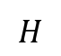
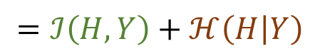
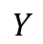
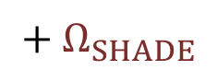
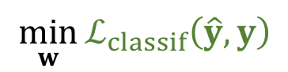
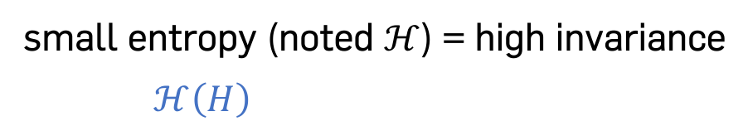
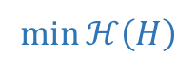
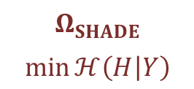
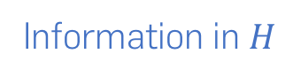
Classification, invariance and entropy
$$\min_{w}{ℒ_{classif}\left(\hat{y},y\right)}$$
$$+ Ω_{SHADE}$$
small entropy (noted $ℋ$) = high invariance $$ℋ\left(H\right)=ℐ\left(H,Y\right)+ℋ\left(H | Y\right)$$
$$=ℐ\left(H,Y\right)+ℋ\left(H | Y\right)$$
Information in $H$
Class-related information
Intra-class variability
$$Ω_{SHADE}$$ $$\min{ℋ\left(H | Y\right)}$$
$$H$$
cats
E
C
$$Y$$
cars
$$\min{ℋ\left(H\right)}$$

Slide 10
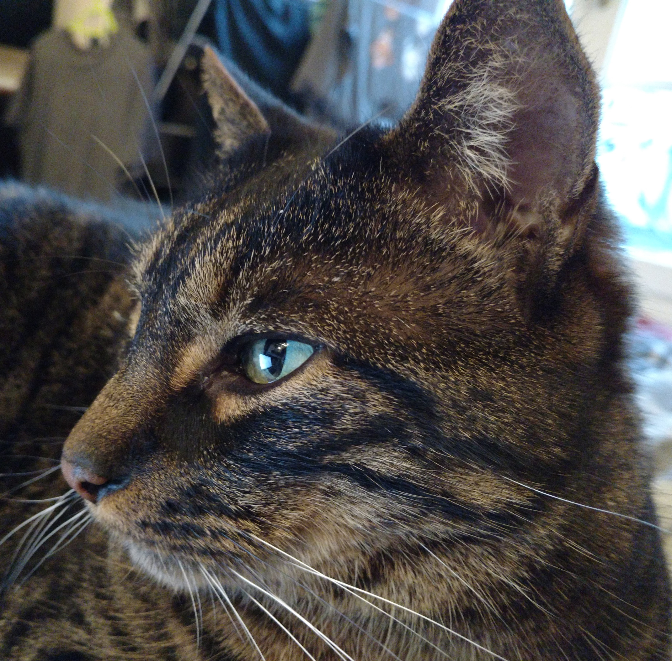
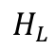
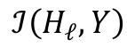
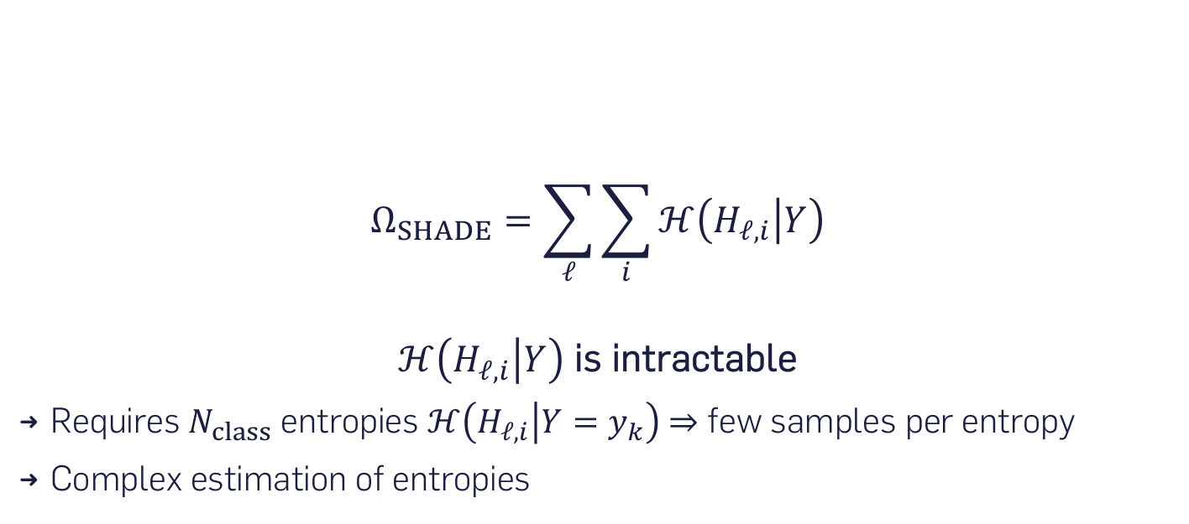
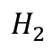
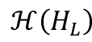
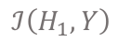
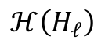
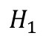
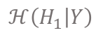
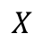
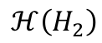
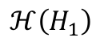
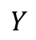
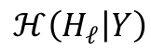
SHADE formulation and challenges
$$X$$
$$H_{1}$$
$$H_{2}$$
$$H_{L}$$
$$Y$$
…
$$ℋ\left(H_{ℓ}\right)$$
$$ℋ\left(H_{1}\right)$$
$$ℋ\left(H_{2}\right)$$
…
$$ℋ\left(H_{L}\right)$$
$$ℐ\left(H_{ℓ},Y\right)$$
$$ℐ\left(H_{1},Y\right)$$
»
»
$$ℋ\left(H_{1} | Y\right)$$
»
$$ℋ\left(H_{ℓ} | Y\right)$$
»
Effect of SHADE: Reduction of conditional entropy
$$Ω_{SHADE}=\sum_{ℓ}{\sum_{i}{ℋ\left(H_{ℓ,i} | Y\right)}}$$
$ℋ\left(H_{ℓ,i} | Y\right)$ is intractable
Requires $N_{class}$ entropies $ℋ\left(H_{ℓ,i} | Y=y_{k}\right)$ $⇒$ few samples per entropy
Complex estimation of entropies

Slide 11
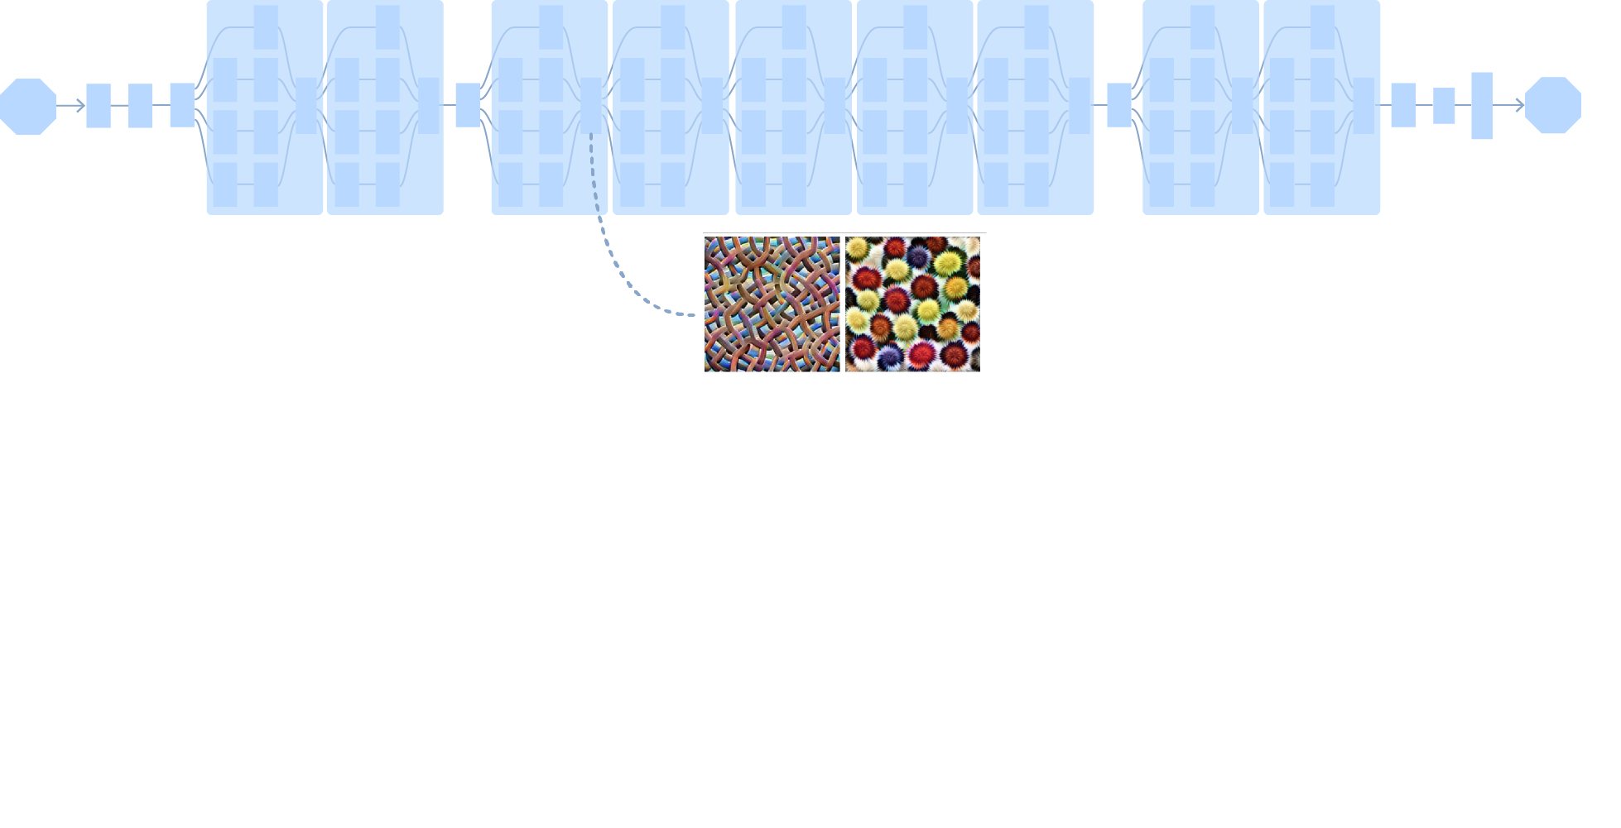
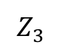
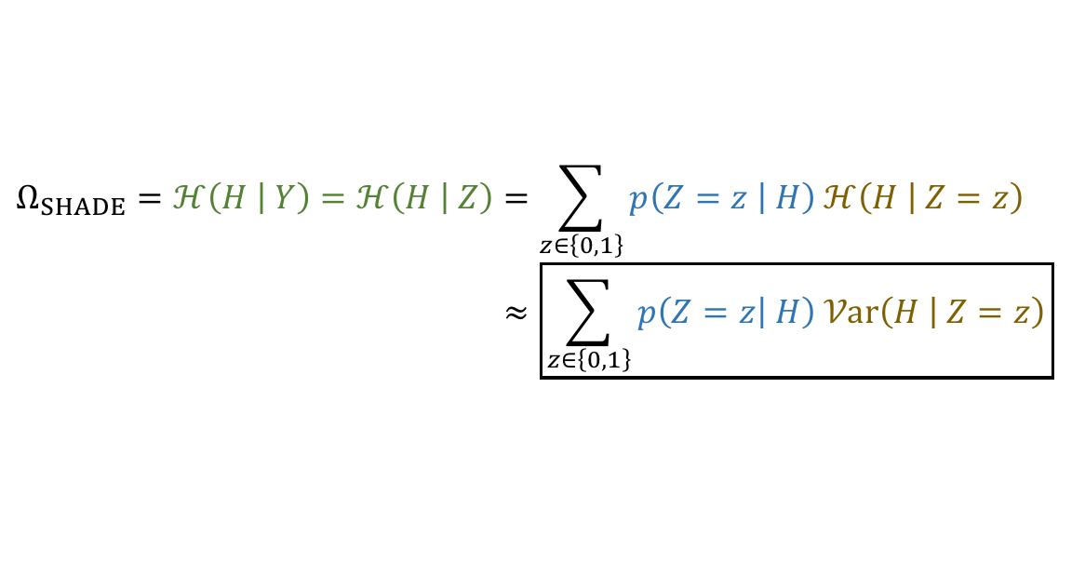
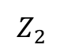
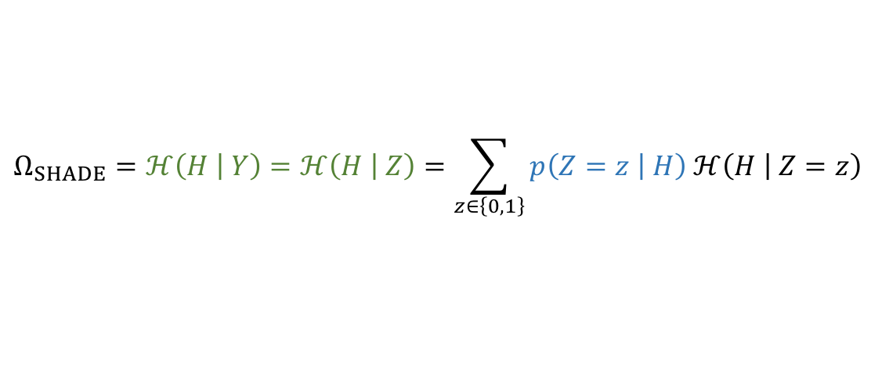
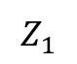
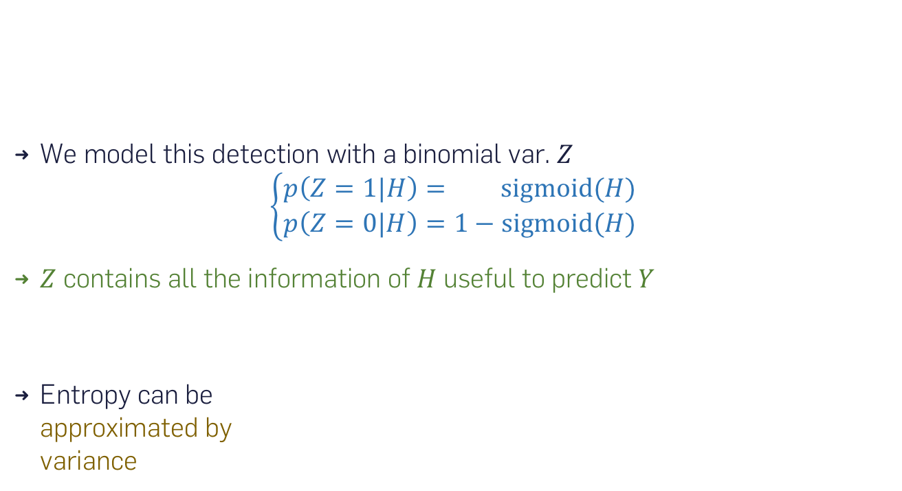
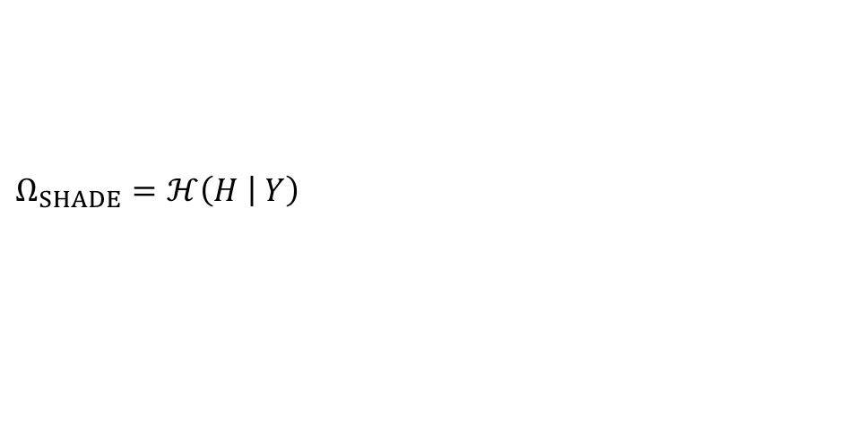
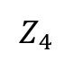
Workarounds – Binary model and variance approx.
Each neuron acts as a binary detector of a specific pattern
$$Z_{1}$$
$$Z_{2}$$
$$Z_{3}$$
$$Z_{4}$$
Examples of patterns represented:
…
We model this detection with a binomial var. $Z$ $\left\{\begin{aligned}p\left(Z=1|H\right)= \operatorname{sigmoid}{(H)} \\ p\left(Z=0|H\right)=1−\operatorname{sigmoid}{(H)}\end{aligned}\right.$
$Z$ contains all the information of $H$ useful to predict $Y$
Entropy can be approximated by variance
$$Ω_{SHADE}=ℋ\left(H | Y\right)=ℋ\left(H | Z\right)=\sum_{z}{p\left(Z | H\right) ℋ\left(H | Z\right)}$$
$$Ω_{SHADE}=ℋ\left(H | Y\right)=ℋ\left(H | Z\right)=\sum_{z∈\left\{0,1\right\}}{p\left(Z=z | H\right) ℋ\left(H | Z=z\right)}$$
$$Ω_{SHADE}=ℋ\left(H | Y\right)=ℋ\left(H | Z\right)=\sum_{z∈\left\{0,1\right\}}{p\left(Z=z | H\right) ℋ\left(H | Z=z\right)} \\ ≈\boxed{\sum_{z∈\left\{0,1\right\}}{p\left(Z=z | H\right) 𝒱ar\left(H | Z=z\right)}}$$

Slide 12
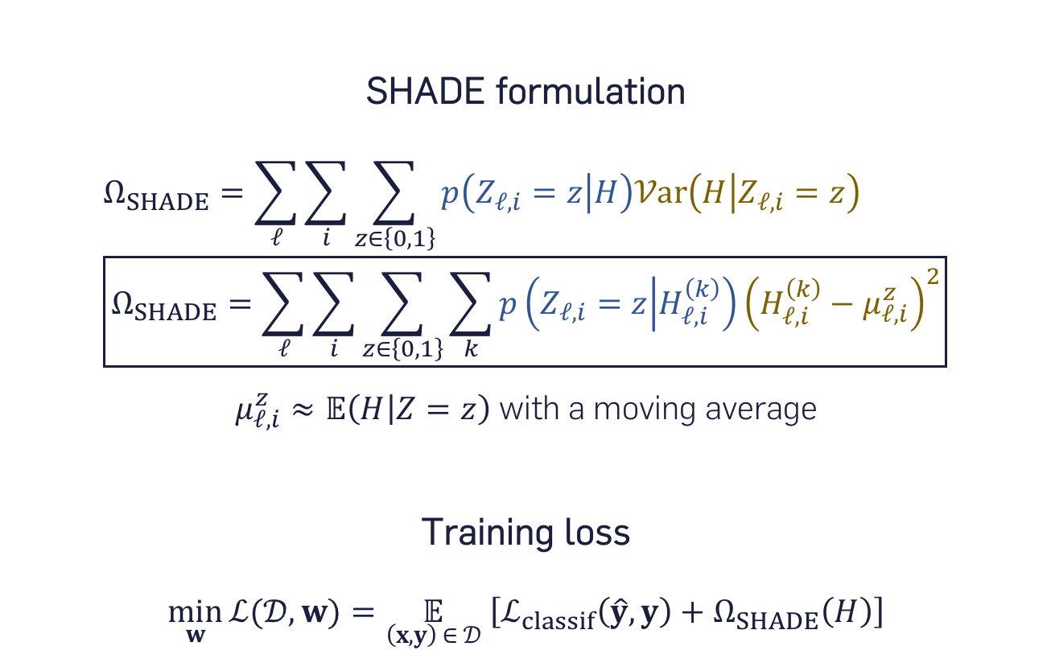
Training algorithm
SHADE formulation
$$Ω_{SHADE}=\sum_{ℓ}{\sum_{i}{\sum_{z∈\left\{0,1\right\}}{p\left(Z_{ℓ,i}=z | H\right)𝒱ar\left(H | Z_{ℓ,i}=z\right)}}} \\ \boxed{Ω_{SHADE}=\sum_{ℓ}{\sum_{i}{\sum_{z∈\left\{0,1\right\}}{\sum_{k}{p\left(Z_{ℓ,i}=z | H_{ℓ,i}^{\left(k\right)}\right)}}{\left(H_{ℓ,i}^{\left(k\right)}−μ_{ℓ,i}^{z}\right)}^{2}}}}$$ $μ_{ℓ,i}^{z}≈𝔼\left(H | Z=z\right)$ with a moving average
Training loss
$$\min_{w}{ℒ(𝒟, w)}=\underset{\left(x,y\right) ∈ 𝒟}{𝔼} \left[ℒ_{classif}\left(\hat{y},y\right)+Ω_{SHADE}\left(H\right)\right]$$

Slide 13
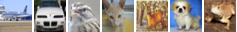
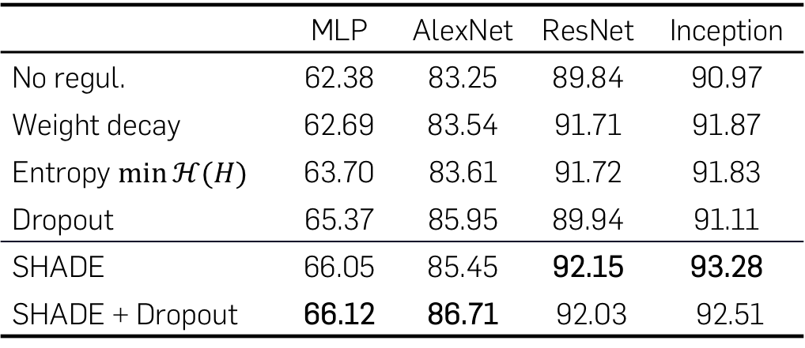
Experiments – Comparison to state of the art on CIFAR-10
Evaluated for classification on CIFAR-10
Applied on 4 standard deep architectures
Test set accuracy for different regularization methods
 | MLP | AlexNet | ResNet | Inception
No regul. | 62.38 | 83.25 | 89.84 | 90.97
Weight decay | 62.69 | 83.54 | 91.71 | 91.87
Entropy $\min{ℋ(H)}$ | 63.70 | 83.61 | 91.72 | 91.83
Dropout | 65.37 | 85.95 | 89.94 | 91.11
SHADE | 66.05 | 85.45 | 92.15 | 93.28
SHADE + Dropout | 66.12 | 86.71 | 92.03 | 92.51

Slide 14
Experiments – Limited training samples
Example of MNIST-M samples
Accuracy with limited train sets

Slide 15
Semi-Supervised Learning HybridNet: Classification and Reconstruction Cooperation
HybridNet: Classification and Reconstruction Cooperation for Semi-Supervised Learning
Thomas Robert, Nicolas Thome, Matthieu Cord ECCV 2018
Regularization
1
Need for large datasets
SHADE
Semi-Supervised Learning
2
Info. structuration
HybridNet
Absence of info. structure
3
Disentangling
DualDis

Slide 16
Semi-Supervised Learning
Using unlabeled data to improve the generalization performance
Labeled
Classification loss
Learn the classification “rule”
Unlabeled
Reconstruction loss
Extract rich representative patterns
bird
ŷ
x
x̂

Slide 17
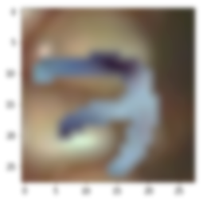
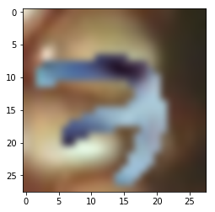
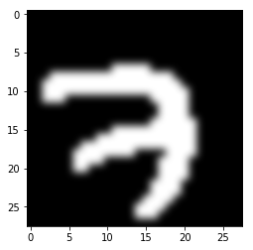






Motivation and related work
Conflicting goals: Classification → invariance / Reconstruction → info. conservation
AE
Objective
x̂
Discr.
Classif. info
Skip
info
Non-discr.
x
h_{c}
h_{u}
h
Related work
skip connections for invariance
SWWAE
(Zhao, 2016)
LadderNet
(Rasmus, 2015)
$ℒ$_{cls}
ŷ
$ℒ$_{cls}
ŷ
x̂
x̂
$ℒ$_{rec}
$ℒ$_{rec}
$$+ε$$
Pooling location info
Noisy representations info
Limit: Fixed type of skipped information

Slide 18
HybridNet core proposition
bird
ŷ
x
W_{c}
x̂
+
W_{u}
HybridNet model
Proposition: Structure the information in two branches
Goals:
Remove information in the path toward classification
Cooperation between the two tasks

Slide 19







Architecture and expected behavior
Discriminative branch
Discriminative info only
Partial reconstruction
Unsupervised branch
Complementary info & reconstruction
$$\text{C}$$
$$\text{y}\text{̂}$$
Discriminative branch
E_{c}
h_{c}
D_{c}
$$\text{x}\text{̂}\text{c}$$
$$\text{x}$$
$$\text{x}\text{̂}$$
E_{u}
h_{u}
$$\text{D}\text{u}$$
$$\text{x}\text{̂}\text{u}$$
Challenges:
Ensure branch cooperation
Guide discriminative features
Unsupervised branch

Slide 20












Training – Branch balancing
Problem: reconstruction from unsup. branch only
Branch balancing of reconstruction with selective backprop
$$ℓ_{br−balance}=\left\{\begin{aligned}{\left\|x−stopgrad\left({\hat{x}}_{u}\right)−{\hat{x}}_{c}\right\|}_{2}^{2}, if \left\|x−{\hat{x}}_{u}\right\|<\left\|x−{\hat{x}}_{c}\right\| \\ &{\left\|x−{\hat{x}}_{u}−stopgrad\left({\hat{x}}_{c}\right)\right\|}_{2}^{2}, otherwise \end{aligned}\right.$$
Intermediate reconstructions
$$\text{C}$$
$$\text{y}\text{̂}$$
E_{c}
D_{c}
Reconstruction gradient in “worst” branch
h_{c}
$$\text{x}\text{̂}\text{c}$$
$$\text{x}$$
$$\text{x}\text{̂}$$
$ℒ$_{rec}
+ branch + complementarity
-
$ℒ$_{rec}
E_{u}
$$\text{D}\text{u}$$
h_{u}
$$\text{x}\text{̂}\text{u}$$
$ℒ\text{rec}\text{−}\text{inter}$
-

Slide 21






Training – Guiding discriminative features
Classification loss
Stability loss e.g. Mean Teacher (Tarvainen, 2017)
Encourage invariance to random variability
Uses virtual labels $z^{\left(i\right)}$, e.g. avg of outputs
$$Ω_{stability}={\left\|{\hat{y}}^{\left(i\right)}−z^{\left(i\right)}\right\|}_{2}^{2}$$
$$\text{C}$$
$$\text{y}\text{̂}$$
$ℒ\text{cls}$
E_{c}
D_{c}
$Ω\text{stability}$
h_{c}
$$\text{x}\text{̂}\text{c}$$
$$\text{x}$$
$$\text{x}\text{̂}$$
$ℒ$_{rec}
+ branch + complementarity
-
E_{u}
$$\text{D}\text{u}$$
h_{u}
$$\text{x}\text{̂}\text{u}$$
$ℒ\text{rec}\text{−}\text{inter}$
-

Slide 22












Experiments – Datasets and training
SVHN
Original dataset
CIFAR-10
STL-10
$$\text{C}$$
$$\text{y}\text{̂}$$
$ℒ\text{cls}$
SSL dataset
E_{c}
D_{c}
$Ω\text{stability}$
Labeled
h_{c}
$$\text{x}\text{̂}\text{c}$$
Unlabeled
$$\text{x}$$
$$\text{x}\text{̂}$$
$ℒ$_{rec}
+ branch + complementarity
-
E_{u}
h_{u}
$$\text{D}\text{u}$$
$$\text{x}\text{̂}\text{u}$$
$ℒ\text{rec}\text{−}\text{inter}$
-

Slide 23











Experiments – Ablation study, quantitative results
Accuracy (%) of the model on 2 standard datasets depending on the loss terms used
✓ |  |  |  |  | 71.5 | 65.6
✓ | ✓ |  |  |  | 74.6 | 69.8
✓ |  | ✓ |  |  | 72.4 | 67.8
✓ |  | ✓ | ✓ |  | 74.0
✓ |  | ✓ | ✓ | ✓ | 75.2
✓ | ✓ | ✓ |  |  | 77.7 | 71.5
✓ | ✓ | ✓ | ✓ |  | 80.8 | 72.2
✓ | ✓ | ✓ | ✓ | ✓ | 81.6 | 74.1
Branch balancing
STL-10
1k labels / 100k imgs
Classif.
Rec. intermed.
CIFAR-10
2k labels / 50k imgs
Stability
Reconstruction
Classif.
baselines
$$\text{C}$$
$$\text{y}\text{̂}$$
$ℒ\text{cls}$
E_{c}
h_{c}
D_{c}
$Ω\text{stability}$
$$\text{x}\text{̂}\text{c}$$
HybridNet
w/o stability
$$\text{x}$$
$$\text{x}\text{̂}$$
$ℒ$_{rec}
+ branch + complement.
-
E_{u}
h_{u}
$$\text{D}\text{u}$$
$$\text{x}\text{̂}\text{u}$$
-
$ℒ\text{rec}\text{−}\text{inter}$
HybridNet
w/ stability

Slide 24
Experiments – Visual analysis
Reconstruction
Discr. branch
Unsup.
branch
Rec. intermed.
Branch balacing
Accuracy
Input
Rec.
x
x̂_{c}
x̂_{u}
x̂
✓
72.4
74.0
75.2
→
+
=
Ablation on CIFAR-10
✓
✓
→
+
=
✓
✓
✓
→
+
=
→
+
=
Visualizations on STL-10
→
+
=

Slide 25
Experiments – State-of-the-art results
Error rate (%) on CIFAR-10 test set
 | Nb. of labeled imgs.. | 1000 | 2000 | 4000
 | Ladder network |  |  | 20.40
 | SWWAE (ours impl.) |  |  | 20.20
 | Stability regularization |  |  | 11.29
 | Temporal Ensembling |  |  | 12.16
 | Mean Teacher ConvLarge | 21.55 | 15.73 | 12.31
ResNet | Supervised baseline | 45.22 | 24.31 | 15.45
 | Mean Teacher | 10.10 |  | 6.23
 | HybridNet | 8.81 | 7.87 | 6.09
Notes:
SSL comparison must be carried carefully (cf. Oliver, 2018)
Similar results on STL-10 and SVHN
Stability-based methods are very sensible to hyperparameters tuning

Slide 26
Disentangling DualDis: Information Separation with Adversarial Learning
DualDis: Dual-Branch Disentangling with Adversarial Learning
Thomas Robert, Nicolas Thome, Matthieu Cord Under review at AAAI 2020
Regularization
1
Need for large datasets
SHADE
Semi-Supervised Learning
2
Info. structuration
HybridNet
Absence of info. structure
3
Disentangling
DualDis

Slide 27


Toward disentangling and editing
$$\text{y}\text{̂}$$
Identity
prediction
$$\text{C}\text{y}$$
Identity information
h_{c}
HybridNet
h_{u}
Style (?) information
Desired direction: Stronger semantics and information separation between the branches

Slide 28


Toward disentangling and editing
$$\text{y}\text{̂}$$
Identity
prediction
$$\text{C}\text{y}$$
Identity information
h_{c}
DualDis
Disentangling
h_{u}
Attribute information
$$\hat{z}$$
Female
No glasses
Blond hair
…
$$\text{C}\text{z}$$
Objectives:
Semantic role of each branch
Disentangle (i.e. separate) two information domains
Latent structure of semantic factors
Image editing capability

Slide 29

Idea and objectives – Disentangling of domains
id 3
id 4
Identity h_{y}
id 1
id 2
Encoder
Decoder
x
$$\hat{x}$$
Female, blonde,
smiling…
Attributes h_{z}
Female, brown hair,
bangs, smiling…
…
Male, black hair,
not smiling…
Male, black hair,
glasses, beard…
D( , ) =
D( , ) =
D( , ) =

Slide 30
Idea and objectives – Intra-domain structure
id 3
id 4
Identity h_{y}
id 1
id 2
Encoder
Decoder
x
female
$$\hat{x}$$
no glasses
glasses
Female, blonde,
smiling…
male
Attributes h_{z}
Female, brown hair,
bangs, smiling…
glasses
…
Male, black hair,
not smiling…
Male, black hair,
glasses, beard…
D( , ) =
D( , ) =
D( , ) =
D( , ) =
D( , ) =
D( , ) =

Slide 31












Architecture and training
Architecture
Training
Adv. classifiers
Main loss
Discr. loss
Identity branch
C_{z}
$${\hat{z}}_{adv}$$
$$ℒ_{adv,z}$$
E_{y}
h_{y}
W_{y}
$$\hat{y}$$
$$ℒ_{disc,z}$$
$$ℒ_{y}$$
x
E
h
D
$$\hat{x}$$
$$ℒ_{rec}$$
Attributes branch
$$ℒ_{z}$$
E_{z}
h_{z}
W_{z}
$$\hat{z}$$
$$ℒ_{disc,y}$$
C_{y}
$${\hat{y}}_{adv}$$
$$ℒ_{adv,y}$$
Loss propagated to
E…
C
Two-branch auto-encoder
Factors representation and linearization by classification
Disentangling by adversarial classification
Discr. loss: model undesired info.
Main adv loss: remove undesired info.

Slide 32












Baselines generalization
Architecture
Training
HybridNet
MTAN
DualDis
Adv. on y
Multi-task
Adv. classifiers
Main loss
Discr. loss
Identity branch
C_{z}
$${\hat{z}}_{adv}$$
$$ℒ_{adv,z}$$
E_{y}
h_{y}
W_{y}
$$\hat{y}$$
$$ℒ_{disc,z}$$
$$ℒ_{y}$$
x
E
h
D
$$\hat{x}$$
$$ℒ_{rec}$$
Attributes branch
$$ℒ_{z}$$
E_{z}
h_{z}
W_{z}
$$\hat{z}$$
$$ℒ_{disc,y}$$
C_{y}
$${\hat{y}}_{adv}$$
$$ℒ_{adv,y}$$
DualDis generalizes many baselines → fair models comparison

Slide 33



Experiments – Datasets
Dataset | Size | Classes (#) | Attr. (#) | Samples
CelebA | 60k | Identity (2000) | Style (40)
Yale-B | 2.4k | Identity (38) | Lighting (14)
NORB | 48k | Category (5) | Lighting + pose (8)

Slide 34









Experiments – Quantitative results (Yale-B)
Evaluated metrics
Identity branch
Accuracy of linear classifiers
relevant info. encoded in $h_{y}$ and $h_{z}$
Error rate of adv. classifiers
undesired info. removed from $h_{y}$ and $h_{z}$
E_{y}
h_{y}
x
E
h
D
$$\hat{x}$$
Attributes branch
E_{z}
h_{z}
W_{y}
W_{z}
C_{y}
C_{z}
Avg.
$$\hat{y}$$
$$\hat{z}$$
$${\hat{y}}_{adv}$$
$${\hat{z}}_{adv}$$
Model | Labels used | Aggr. Metric | Accuracy |  | Disentangling
 |  |  | $$h_{y}→y$$ | $$h_{z}→z$$ | $$h_{z}→y_{adv}$$ | $$h_{y}→z_{adv}$$
Multi-task classif. | y, z
HybridNet-like | y
HybridNet-like + attr | y, z
MTAN (Liu, 2018) | y, z, z_{test}
Adv. on y only (Hadad, 2018) | y
DualDis | y, z
Model | Labels used | Aggr. Metric | Accuracy |  | Disentangling
 |  |  | $$h_{y}→y$$ | $$h_{z}→z$$ | $$h_{z}→y_{adv}$$ | $$h_{y}→z_{adv}$$
Multi-task classif. | y, z | 81.5 | 98.5% | 97.2% | 85.3% | 45.1%
HybridNet-like | y | 65.3 | 97.6% | 93.7% | 23.3% | 46.5%
HybridNet-like + attr | y, z | 80.5 | 99.0% | 96.9% | 80.0% | 46.1%
MTAN (Liu, 2018) | y, z, z_{test} | — | 98.4% | — | — | 70.3%
Adv. on y only (Hadad, 2018) | y | 79.8 | 98.3% | 84.1% | 92.5% | 44.4%
DualDis | y, z | 92.0 | 98.6% | 97.3% | 98.8% | 73.4%
Model | Labels used | Aggr. Metric | Accuracy |  | Disentangling
 |  |  | $$h_{y}→y$$ | $$h_{z}→z$$ | $$h_{z}→y_{adv}$$ | $$h_{y}→z_{adv}$$

Slide 35

Experiments – Semi-supervised learning
Limit of DualDis: requires attributes labels
Need can be reduced by SSL
SSL results on CelebA
Nb. attr. labels | Aggr. metric | Accuracy |  | Disentangling
 |  | $$h_{y}→y$$ | $$h_{z}→z$$ | $$h_{z}→y_{adv}$$ | $$h_{y}→z_{adv}$$
2000 | 66.8 | 71.0% | 85.0% | 98.4% | 12.7%
48000 (full labels) | 68.0 | 71.1% | 88.6% | 97.3% | 14.9%

Slide 36

Experiments – Image editing
Input
Attribute modification strength
remove
0
add
Represent an image
$$E\left(x\right)→h_{y},h_{z}$$
Edit the representation
$$h_{z}^{′}=h_{z}+εw_{z,i}$$
Generate a new image
$$D\left(h_{y},h_{z}^{′}\right)={\hat{x}}^{′}$$
Female / Male
Eyeglasses
Heavy Makeup
Smiling
Beard
Bangs
Blond Hair
Brown Hair

Slide 37




Experiments – Semantic data augmentation
For each train image, generate variations in attributes
Original image
Generated variants
→
…
$$𝒟_{gen}$$
$$𝒟_{train}$$
Classifier
Identity
$$\hat{y}$$
Classifier accuracy on Yale-B test set
Train set $$\left|𝒟_{train}\right|$$ | $$𝒟_{train}$$ Baseline | $$𝒟_{train}+𝒟_{gen}$$ Nb. generated samples per class
 |  | 10 | 20 | 30 | 60
240 | 48.9% | 51.8% | 55.5% | 56.8% | 58.6%
360 | 69.1% | 70.5% | 72.6% | 73.1% | 75.6%
480 | 78.9% | 79.3% | 80.1% | 81.6% | 82.8%

Slide 38
Conclusion

Slide 39
Contributions
Invariance without prior
Many types of architectures
Regularization
Semi- supervised learning
Information structuration
Disentangling
1
Large labeled datasets
Unstructured latent representations
SHADE
New dual branch framework
Freedom in info. separation
2
HybridNet
Versatile architecture
Effective domain disentangling
Interesting SSL and DA results
3
DualDis

Slide 40
Perspectives
Domain adaptation
Separate domain specific and domain agnostic features
Generate data for the target domain
Model (source)
Source dataset
Adaptation
Model (target)
Target dataset
Unknown
label

Slide 41
Perspectives
Bridging the gap between discriminative and generative models
Reversible models
Latent structure & model of factors’ internal diversity
Semantic data augmentation
Data space
Latent space
Labels
Glasses
Encode
Interpret
Makeup
Decode
Generate
Hat
Mustache
…
Smiling

Slide 42

Thank You!
Thomas Robert
MLIA
Matthieu Cord
MLIA
Thesis director
Nicolas Thome
CNAM
Thesis co-director
Publications:
DualDis: Dual-Branch Disentangling with Adversarial Learning. T. Robert, N. Thome, M. Cord. Under review, AAAI 2020.
HybridNet: Classification and Reconstruction Cooperation for Semi-Supervised Learning. T. Robert, N. Thome, M. Cord. ECCV, 2018.
SHADE: Information-Based Regularization for Deep Learning. M. Blot, T. Robert, N. Thome, M. Cord. Best paper ICIP, 2018.

Slide 43
References ⠐ Appendix

Slide 44
References
Achille, A. and S. Soatto (2016). “Information Dropout: learning optimal representations through noisy computation”. In: arXiv.
Alemi, Alexander, Ian Fischer, Joshua V. Dillon, and Kevin Murphy (2017). “Deep Variational Information Bottleneck”. In: ICLR.
Bousmalis, Konstantinos, George Trigeorgis, Nathan Silberman, Dilip Krishnan, and Dumitru Erhan (2016). “Domain separation networks”. In: NIPS.
Chang, Wei-Lun, Hui-Po Wang, Wen-Hsiao Peng, and Wei-Chen Chiu (2019). “All about Structure: Adapting Structural Information across Domains for Boosting Semantic Segmentation”. In: CVPR.
Chen, Tian Qi, Xuechen Li, Roger B Grosse, and David K Duvenaud (2018). “Isolating sources of disentanglement in variational autoencoders”. In: NeurIPS.
Dupont, Emilien (2018). “Learning disentangled joint continuous and discrete representations”. In: NeurIPS.
Dyk, David A. van and Xiao-Li Meng (2001). “The Art of Data Augmentation”. In: Journal of Computational and Graphical Statistics.
Engel, Jesse, Matthew Hoffman, and Adam Roberts (2018). “Latent Constraints: Learning to Generate Conditionally from Unconditional Generative Models”. In: ICLR.
Gomez, Aidan N, Mengye Ren, Raquel Urtasun, and Roger B Grosse (2017). “The Reversible Residual Network: Backpropagation Without Storing Activations”. In: NIPS.
Goodfellow, Ian, Jean Pouget-Abadie, Mehdi Mirza, Bing Xu, David Warde-Farley, Sherjil Ozair, Aaron Courville, and Yoshua Bengio (2014). “Generative Adversarial Nets”. In: NIPS.
Hadad, Naama, Lior Wolf, and Moni Shahar (2018). “A Two-Step Disentanglement Method”. In: CVPR.
He, Kaiming, Xiangyu Zhang, Shaoqing Ren, and Jian Sun (2016). “Deep Residual Learning for Image Recognition”. In: CVPR.

Slide 45
References
He, Zhenliang, Wangmeng Zuo, Meina Kan, Shiguang Shan, and Xilin Chen (2019). “Attgan: Facial attribute editing by only changing what you want”. In: TIP.
Higgins, Irina, David Amos, David Pfau, Sebastien Racaniere, Loic Matthey, Danilo Rezende, and Alexander Lerchner (2018). “Towards a Definition of Disentangled Representations”. In: arXiv.
Higgins, Irina, Loic Matthey, Arka Pal, Christopher Burgess, Xavier Glorot, Matthew Botvinick, Shakir Mohamed, and Alexander Lerchner (2017). “beta-vae: Learning basic visual concepts with a constrained variational framework”. In: ICLR.
Hu, Qiyang, Attila Szabó, Tiziano Portenier, Paolo Favaro, and Matthias Zwicker (2018). “Disentangling Factors of Variation by Mixing Them”. In: CVPR.
Ioffe, Sergey and Christian Szegedy (2016). “Batch Normalization: Accelerating Deep Network Training by Reducing Internal Covariate Shift”. In: JMLR.
Jacobsen, Jörn-Henrik, Arnold Smeulders, and Edouard Oyallon (2018). “i-RevNet: Deep Invertible Networks”. In: ICLR.
Jaiswal, Ayush, Rex Yue Wu, Wael Abd-Almageed, and Prem Natarajan (2018). “Unsupervised Adversarial Invariance”. In: NeurIPS.
Karras, Tero, Samuli Laine, and Timo Aila (2019). “A style-based generator architecture for generative adversarial networks”. In: CVPR.
Kim, Hyunjik and Andriy Mnih (2018). “Disentangling by factorising”. In: arXiv.
Kingma, Diederik P and Prafulla Dhariwal (2018). “Glow: Generative flow with invertible 1x1 convolutions”. In: NeurIPS.
Klys, Jack, Jake Snell, and Richard Zemel (2018). “Learning Latent Subspaces in Variational Autoencoders”. In: NeurIPS.

Slide 46
References
Kokkinos, Iasonas (2017). “Ubernet: Training a universal convolutional neural network for low-, mid-, and high-level vision using diverse datasets and limited memory”. In: CVPR.
Krizhevsky, Alex, Ilya Sutskever, and Geoffrey Hinton (2012). “Imagenet classification with deep convolutional neural networks”. In: NIPS.
Krogh, Anders and John A. Hertz (1992). “A Simple Weight Decay Can Improve Generalization”. In: NIPS.
Kulkarni, Tejas D, William F. Whitney, Pushmeet Kohli, and Josh Tenenbaum (2015). “Deep Convolutional Inverse Graphics Network”. In: NIPS.
Laine, Samuli and Timo Aila (2017). “Temporal Ensembling for Semi-Supervised Learning”. In: ICLR.
Lample, Guillaume, Neil Zeghidour, Nicolas Usunier, Antoine Bordes, Ludovic Denoyer, and Marc’Aurelio Ranzato (2017). “Fader Networks: Manipulating Images by Sliding Attributes”. In: NIPS.
Liu, Yang, Zhaowen Wang, Hailin Jin, and Ian Wassell (2018). “Multi-Task Adversarial Network for Disentangled Feature Learning”. In: CVPR.
Liu, Yu, Fangyin Wei, Jing Shao, Lu Sheng, Junjie Yan, and Xiaogang Wang (2018). “Exploring Disentangled Feature Representation Beyond Face Identification”. In: CVPR.
Liu, Ziwei, Ping Luo, Xiaogang Wang, and Xiaoou Tang (2015). “Deep Learning Face Attributes in the Wild”. In: ICCV.
Lucas, Thomas, Konstantin Shmelkov, Karteek Alahari, Cordelia Schmid, and Jakob Verbeek (2019). “Adversarial training of partially invertible variational autoencoders”. In: arXiv.
Mathieu, Michael F, Junbo Jake Zhao, Junbo Zhao, Aditya Ramesh, Pablo Sprechmann, and Yann LeCun (2016). “Disentangling factors of variation in deep representation using adversarial training”. In: NIPS.

Slide 47
References
Netzer, Yuval, Tao Wang, Adam Coates, Alessandro Bissacco, Bo Wu, and Andrew Y Ng (2011). “Reading digits in natural images with unsupervised feature learning”. In: NIPS-W.
Olah, Chris, Alexander Mordvintsev, and Ludwig Schubert (2017). “Feature Visualization”. In: Distill.
Perarnau, Guim, Joost Van De Weijer, Bogdan Raducanu, and Jose M Álvarez (2016). “Invertible conditional gans for image editing”. In: NIPS-W.
Rasmus, Antti, Mathias Berglund, Mikko Honkala, Harri Valpola, and Tapani Raiko (2015). “Semi-supervised learning with ladder networks”. In: NIPS.
Russakovsky, Olga, Jia Deng, Hao Su, Jonathan Krause, Sanjeev Satheesh, Sean Ma, Zhiheng Huang, Andrej Karpathy, Aditya Khosla, Michael Bernstein, Alexander C. Berg, and Li Fei-Fei (2015). “ImageNet Large Scale Visual Recognition Challenge”. In: IJCV.
Sajjadi, Mehdi, Mehran Javanmardi, and Tolga Tasdizen (2016). “Regularization With Stochastic Transformations and Perturbations for Deep Semi-Supervised Learning”. In: NIPS.
Shamir, O., S. Sabato, and Naftali Tishby (2010). “Learning and generalization with the information bottleneck”. In: Theoretical Computer Science.
Simonyan, Karen and Andrew Zisserman (2015). “Very deep convolutional networks for large-scale image recognition”. In: ICLR.
Srivastava, Nitish, Geoffrey Hinton, Alex Krizhevsky, Ilya Sutskever, and Ruslan Salakhutdinov (2014). “Dropout: A Simple Way to Prevent Neural Networks from Overfitting”. In: JMLR.
Szegedy, Christian, Wei Liu, Yangqing Jia, Pierre Sermanet, Scott Reed, Dragomir Anguelov, Dumitru Erhan, Vincent Vanhoucke, and Andrew Rabinovich (2015). “Going deeper with convolutions”. In: CVPR.
Szegedy, Christian, Vincent Vanhoucke, Sergey Ioffe, Jon Shlens, and Zbigniew Wojna (2016). “Rethinking the inception architecture for computer vision”. In: CVPR.

Slide 48
References
Tarvainen, Antti and Harri Valpola (2017). “Mean teachers are better role models: Weight-averaged consistency targets improve semi-supervised deep learning results”. In: NIPS.
Tishby, Naftali, F. C. Pereira, and W. Bialek (1999). “The information bottleneck method”. In: Annual Allerton Conference on Communication, Control and Computing.
Tishby, Naftali and Noga Zaslavsky (2015). “Deep learning and the information bottleneck principle”. In: Information Theory Workshop (ITW). IEEE.
Tran, Luan, Xi Yin, and Xiaoming Liu (2017). “ Disentangled Representation Learning GAN for Pose-Invariant Face Recognition ”. In: CVPR.
Wang, Ting-Chun, Ming-Yu Liu, Jun-Yan Zhu, Andrew Tao, Jan Kautz, and Bryan Catanzaro (2018). “High-resolution image synthesis and semantic manipulation with conditional gans”. In: CVPR.
Wojna, Zbigniew, Vittorio Ferrari, Sergio Guadarrama, Nathan Silberman, Liang-Chieh Chen, Alireza Fathi, and Jasper Uijlings (2017). “The Devil is in the Decoder”. In: BMVC.
Zhang, Chiyuan, Samy Bengio, Moritz Hardt, Benjamin Recht, and Oriol Vinyals (2017). “Understanding deep learning requires rethinking generalization”. In: ICLR.
Zhang, Yuting, Kibok Lee, and Honglak Lee (2016). “Augmenting Supervised Neural Networks with Unsupervised Objectives for Large-scale Image Classification”. In: ICML.
Zhao, Junbo, Michael Mathieu, Ross Goroshin, and Yann LeCun (2016). “Stacked What-Where Auto-encoders”. In: ICLR-W.

Slide 49
Appendix for SHADE

Slide 50

SHADE – Development details
Layer-wise: $Ω_{layers}=\sum_{l}{ℋ\left(H_{l} | Y\right)}$
Unit-wise: $Ω_{layers}<Ω_{units}=\sum_{l}{\sum_{i}{ℋ\left(H_{l,i} | Y\right)}}$
Sufficient statistics assumption: $Y→Z→X→H$ $⇒ℐ\left(H,Y\right)=ℐ\left(H,Z\right)⇒ℋ\left(H | Y\right)=ℋ\left(H | Z\right)$
Unit regularizer with $Z$: $ω=ℋ\left(H | Y\right)=ℋ\left(H | Z\right)=\sum_{z}{p\left(Z | H\right) ℋ\left(H | Z\right)}$
Variance bound: $ℋ\left(H | Z\right)<\frac{1}{2}\ln\left(2πe𝒱ar\left(H | Z\right)\right)$
Variance estimated using moving average of the expectation $𝔼\left(H | Z\right)$

Slide 51



SHADE – Implementation details

Slide 52

SHADE – ImageNet results

Slide 53


SHADE – Binary model hypothesis

Slide 54
Appendix for HybridNet

Slide 55









Related work
Reconstruction-based $⇒$ information skip
Stability-based
$ℒ$_{cls}
$ℒ$_{cls}
ŷ
Mean Teacher
(Tarvainen, 2017)
h
ŷ
x̂
SWWAE
(Zhao, 2016)
$ℒ$_{rec}
$ℒ$_{stab}
Pooling location info
Enforces invariance to sources of random variability
Create virtual targets $z^{\left(i\right)}$, e.g. avg of outputs
$$ℒ_{stab}={\left\|{\hat{y}}^{\left(i\right)}−z^{\left(i\right)}\right\|}_{2}$$
ŷ
$ℒ$_{cls}
x̂
LadderNet
(Rasmus, 2015)
$ℒ$_{rec}
$$+ε$$
Noisy representations info.
Limits
Does not encourage extraction of more generic patterns
Fixed type of skipped information

Slide 56

HybridNet – Fusion strategies
Richer interactions
More complex to control
More simple interactions
Possible to control each branch directly

Slide 57
HybridNet – Architecture example
ŷ
Original classifier
E_{c}
D_{c}
x̂_{c}
h_{c}
x
x̂
E_{u}
D_{u}
x̂_{u}
h_{u}
Pooling switches
Convolution
Max Pooling
Upsampling / Unpooling

Slide 58

HybridNet – Ablation study
CIFAR-10, ConvLarge

Slide 59

HybridNet – Architecture with SHADE

Slide 60


HybridNet – SHADE results

Slide 61
HybridNet – Visual results
Input
Discr.
Unsup.
Rec.
Input
Discr.
Unsup.
Rec.
x
x̂_{c}
x̂_{u}
x̂
x
x̂_{c}
x̂_{u}
x̂
→
+
=
→
+
=
→
+
=
→
+
=
→
+
=
→
+
=
→
+
=
→
+
=
→
+
=
→
+
=

Slide 62

HybridNet – Ablation study, visual analysis
Final rec.
Model accuracy
Stability
Intermed. rec.
Complement.
Visualisations
x x̂_{c} x̂_{u} x̂ x x̂_{c} x̂_{u} x̂ x x̂_{c} x̂_{u} x̂
✓
72.4
74.0
75.2
81.6
✓
✓
✓
✓
✓
✓
✓
✓
✓
✓
72.4
74.0
75.2
81.6
✓
✓
✓
✓
✓
✓
✓
✓
✓

Slide 63

HybridNet – Branch balancing effect on loss

Slide 64
Appendix for DualDis

Slide 65




DualDis – Related work
Unsupervised disentangling
(Higgins, 2017; Chen, 2018; Kim, 2018; Dupont, 2018; Hu, 2018; …)
Produce independent neurons or groups of neurons
No interpretation of the neurons’ role
Specific metrics (~ verify 1 neuron for each labeled factor)
h
E
D
$$\text{x}$$
$$\text{x}\text{̂}$$
Supervised disentangling (Perarnau, 2016; Lample, 2017; Mathieu, 2016; Klys, 2018; Hadad, 2018; Liu, 2018; …)
h_{y}
Separate 2 information domains
Use labels for 1 or 2 domains
Used for discriminative and generative tasks
E
D
$$\text{x}$$
$$\text{x}\text{̂}$$
h_{z}

Slide 66

DualDis – GAN & VAE

Slide 67

DualDis – Quantitative results
 |  | Model | Labels used | Aggr. Metric | Accuracy |  | Disentangling
 |  |  |  |  | $$h_{y}→y$$ | $$h_{z}→z$$ | $$h_{z}→y_{adv}$$ | $$h_{y}→z_{adv}$$
CelebA | (A) | Multi-task classif. | y, z | 61.1 | 77.6% | 91.8% | 65.5% | 9.5%
 | (B) | HybridNet-like | y | 65.1 | 73.0% | 82.4% | 95.5% | 9.4%
 | (B') | HybridNet-like + attr | y, z | 65.2 | 72.7% | 90.1% | 88.5% | 9.5%
 | (C) | MTAN | y, z, z_{test} | — | 68.9% | — | — | 13.8%
 | (D) | UAI adv. loss | y | 63.7 | 67.9% | 80.3% | 97.3% | 9.3%
 | (D') | UAI adv. loss + attr | y, z | 65.0 | 68.0% | 89.4% | 92.9% | 9.5%
 | (E) | Adv. on y only | y | 64.7 | 69.2% | 83.6% | 96.4% | 9.6%
 |  | DualDis | y, z | 68.0 | 71.1% | 88.6% | 97.3% | 14.9%
Yale-B | (A) | Multi-task classif. | y, z | 81.5 | 98.5% | 97.2% | 85.3% | 45.1%
 | (B) | HybridNet-like | y | 65.3 | 97.6% | 93.7% | 23.3% | 46.5%
 | (B') | HybridNet-like + attr | y, z | 80.5 | 99.0% | 96.9% | 80.0% | 46.1%
 | (C) | MTAN | y, z, z_{test} | — | 98.4% | — | — | 70.3%
 | (D) | UAI adv. loss | y | 60.0 | 98.6% | 65.5% | 28.1% | 48.0%
 | (D') | UAI adv. loss + attr | y, z | 65.1 | 96.1% | 95.8% | 44.4% | 24.1%
 | (E) | Adv. on y only | y | 79.8 | 98.3% | 84.1% | 92.5% | 44.4%
 |  | DualDis | y, z | 92.0 | 98.6% | 97.3% | 98.8% | 73.4%
NORB | (A) | Multi-task classif. | y, z | 53.7 | 93.0% | 84.2% | 13.5% | 24.0%
 | (B) | HybridNet-like | y | 51.1 | 93.3% | 76.8% | 12.2% | 22.1%
 | (B') | HybridNet-like + attr | y, z | 52.5 | 92.9% | 84.1% | 10.7% | 22.2%
 | (C) | MTAN | y, z, z_{test} | — | 92.2% | — | — | 30.5%
 | (D) | UAI adv. loss | y | 51.8 | 92.8% | 76.0% | 13.7% | 24.7%
 | (D') | UAI adv. loss + attr | y, z | 52.5 | 93.2% | 82.8% | 8.0% | 26.0%
 | (E) | Adv. on y only | y | 67.3 | 92.2% | 76.9% | 78.9% | 21.1%
 |  | DualDis | y, z | 72.3 | 93.5% | 84.5% | 80.7% | 30.5%

Slide 68
DualDis – Image editing
Input
Reconstr.
w/o modif.
- attribute removed + attribute added
Female / Male
Eyeglasses
Heavy Makeup
Smiling
Beard
Bangs
Blond Hair
Brown Hair

Slide 69
DualDis – Visual results on Yale and NORB
Input
Input
Rec.
Camera elevation
Light sources
Factor changed
Camera angle
Light variations

Slide 70


DualDis – Disentangling visualization
Initial images. x^{(id)} : Identity source / x^{(attr)} : Attribute source
x^{(id)}
x^{(attr)}
DualDis
Baseline
without z
Generations from $\left(h_{y}^{\left(id\right)},h_{z}^{\left(attr\right)}\right)$ produced by DualDis and the baseline
Identity of
DualDis
&
Attributes of
Baseline

